Slide 1

Mobile Commerce
SE-413 E-Commerce
Week 10

Slide 2
What is m-Commerce?
An advancement of E-Commerce.
Enables people to buy and sell goods or services using a mobile phone or tablet device.
Includes any monetary transaction completed using a mobile device
Not just e-store based selling

Slide 3
m-Commerce
Includes
Mobile money transfers.
Electronic ticketing/boarding passes.
Digital content purchases.
Mobile banking.
Contactless payments and in-app payments.
Location-based services.
Mobile marketing, coupons and loyalty cards.

Slide 4
Advantages of m-Commerce
Better overall customer experience.
Reach, Mobility, Customized experience
Massive Growth Potential.
Mobiles are 6% of US retail sales. (Statistica 2021)
Easy Omni-Channel usage.
Works as a separate stream or in hybrid
Additional Payment options (Digital Wallets)
Large number of contactless, hassle free options

Slide 5
Disadvantages of m-Commerce
Constant optimization due to changing customer behavior.
Confusing selection of payment options.
More options, more confusion
Ever-present customer doubts about mobile security.
Apps require lots of permission.
Where is my data being stored?
Being Monitored all the time? Ads Analytics!

Slide 6
Fraud in m-Commerce
Smishing
Lost/Stolen device fraud
Weak Security (Starbucks 2015 Attack)
2FA
KBC
Velocity Filter

Slide 7
Digital Wallets
Mobile Apps that securely store payment information using “Tokenization”.
Contact-less payment
Can also store
Gift Cards, Memberships, Tickets.
Digital Wallet can be from:
Bank
Payment Service (Paypal, Amazon, Jazz Cash)

Slide 8
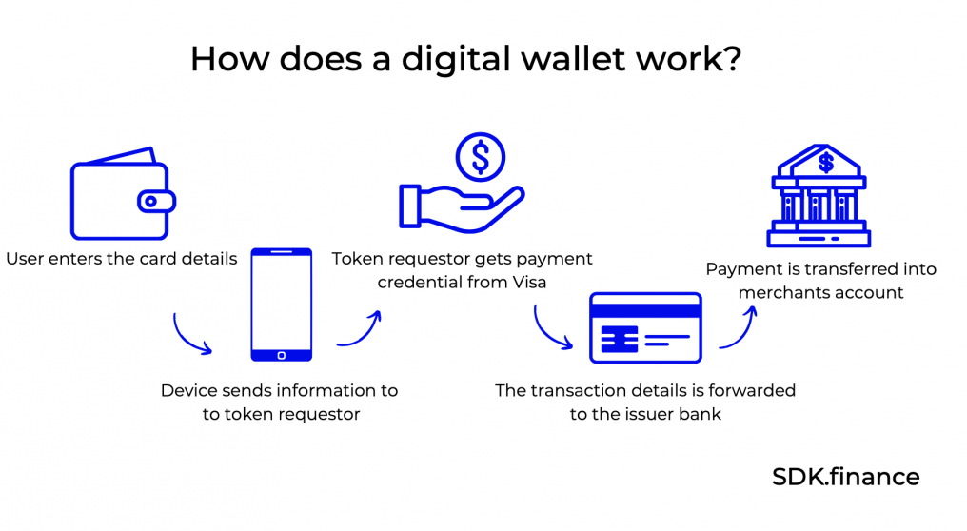
Digital Wallet

Slide 9
Native Apps Vs Web View
Native Apps
Built for specific mobile operating systems.
Android vs iOS
Java vs Objective-C or Swift
Cross Platform: React Native, Xamarin
Hybrid Apps (Web View)
A dedicated mobile browser window, contained within the shell of a mobile app.
Web app view replaced with Mobile UI elements.
Example: Cordova, Ionic

Slide 10
Native Apps vs Web View
Native Apps
Easier to get Store Approval
Performance
Able to use full device capabilities
Hybrid Apps
Single Code Base
More Cost Effective
Easier to integrate with web (Theme, features, flow)

Slide 11
Issues with m-Commerce Apps
Lack of real estate.
Harder to fill forms.
Hybrid Apps have limited functionality/additional bugs.

Slide 12
Strategies for m-Commerce
One step checkout.
First time details provision. Often the first launch.
Creative use of notifications.
Store Integration
Frequent updates to apps. More reason to browse.
Gamification
Food Panda App

Slide 13
ASO (App Store Optimization)
https://slideslive.com/38982484/aso-is-not-seo

Slide 14
AR in mCommerce
https://www.simicart.com/blog/ar-augmented-reality-app-ecommerce/

